Slide 1

HR CASE STUDY SUBMISSION
Group Name: SBSN
Srinivas Adepu, Biswadeep Basu, Satyam Singh, Nikita Jhalani

Slide 2
BUSINESS UNDERSTANDING
A large company named XYZ, employs, at any given point of time, around 4000 employees. However, every year, around 15% of its employees leave the company and need to be replaced with the talent pool available in the job market. The management believes that this level of attrition (employees leaving, either on their own or because they got fired) is bad for the company, because of the following reasons -
The former employees’ projects get delayed, which makes it difficult to meet timelines, resulting in a reputation loss among consumers and partners
A sizeable department has to be maintained, for the purposes of recruiting new talent
More often than not, the new employees have to be trained for the job and/or given time to acclimatize themselves to the company
As a result of this analysis, we should be able to understand what factors company should focus on, in order to curb attrition.

Slide 3
Goal of the case study
We are required to model the probability of attrition using a logistic regression. The results thus obtained will be used by the management to understand what changes they should make to their workplace, in order to get most of their employees to stay. Also, they want to know which of these variables is most important and needs to be addressed right away.

Slide 4
THE DATA
The data contains information about 4410 past Employees across one year with following information in data set:
General data- It contains all basic information of each employee.
In time : It contains daily in time of each employee in the office.
Out time : It contains daily out time of each employee from the office.
Employee survey data : It contains the response of each employee in survey conducted by company.
Manager survey data : it contains the manager reviews for each employee.
Considering ‘Employee id’ as the primary key, all the data sets are combined to create master data set.

Slide 5
DATA UNDERSTANDING
The following primary understanding was achieved.
Data spans over a period of one year. i.e. 2014
Attrition rate of employees is around 16% in last year.
Attrition is dependent on total 27 factors.

Slide 6
DATA CLEANING AND PREPARATION
Once the primary analysis was over, the data quality issues and any other inconsistencies were identified and corrected to suit the analysis.
Necessary formatting and standardization of the date entries were made.
We calculated number of leaves taken by an employee in a year from In_time data set.
We calculated average hours spent in office by an employee in a year from in_time and out_time data set.
We droped few of the below columns which will not help in the analysis. "EmployeeCount","Over18","StandardHours","EmployeeID"
The following derived metrics are created to help in the analysis: “Leaves",“avg_duration”
NA replacements done with mode for categorical variables.
Outliers were identified by the following calculation for the Monthly_Income column 75th percentile + 1.5*(Inter Quartile Range)
Feature standardization as done for continuous variable. To keep them on same scale.
Created dummy variable for all categorical variable.
Splitting the final data into training and test for model preparation.

Slide 7
ANALYSIS
With the data in hand. We went ahead and plotted some plots against Attrition rate across various variable to gain insights.
The following plots are done in R. We have used ggplot2 in R for plotting
Note: Corresponding Tableau Plots are also shown for better aesthetics

Slide 8
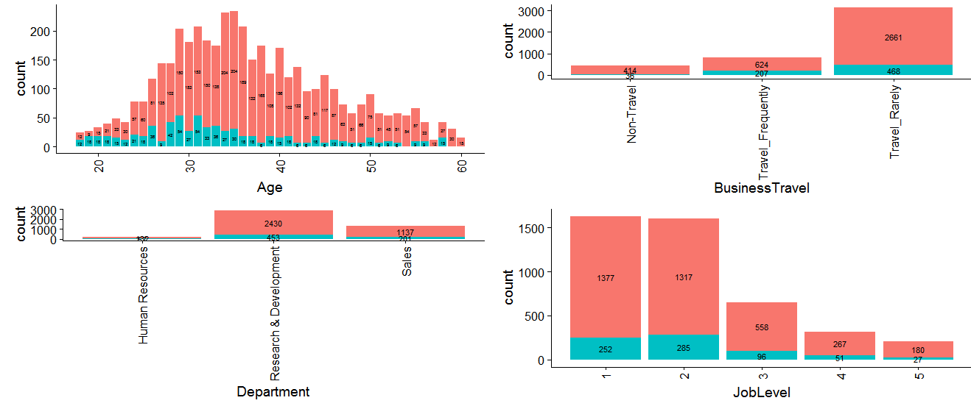
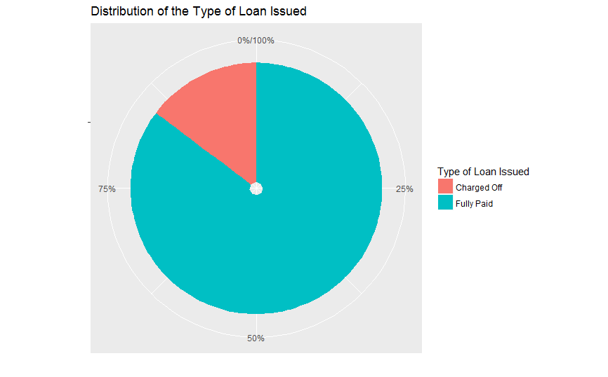

Slide 9
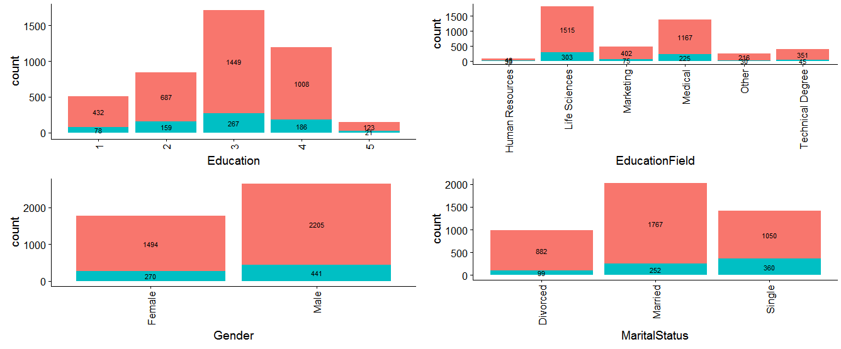

Slide 10
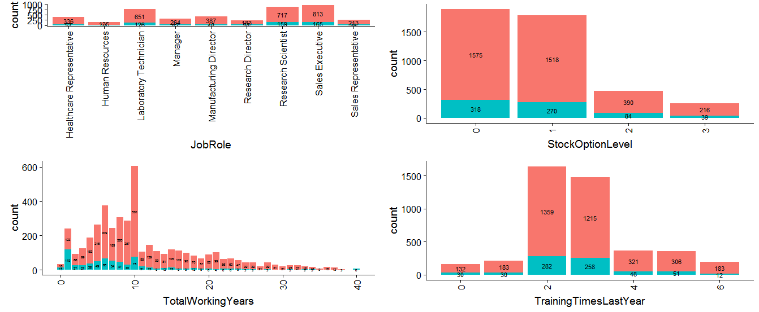

Slide 11
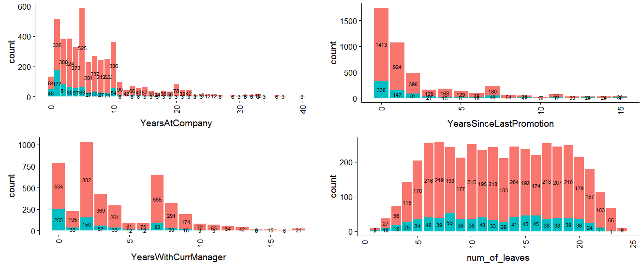

Slide 12
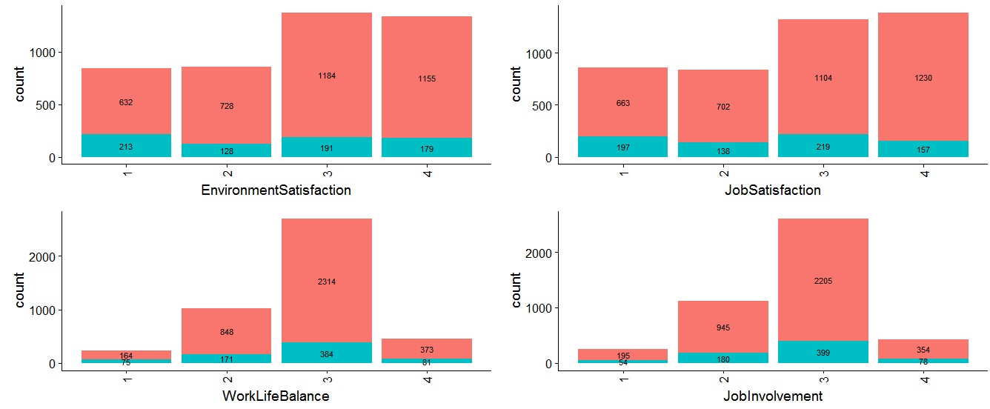

Slide 13
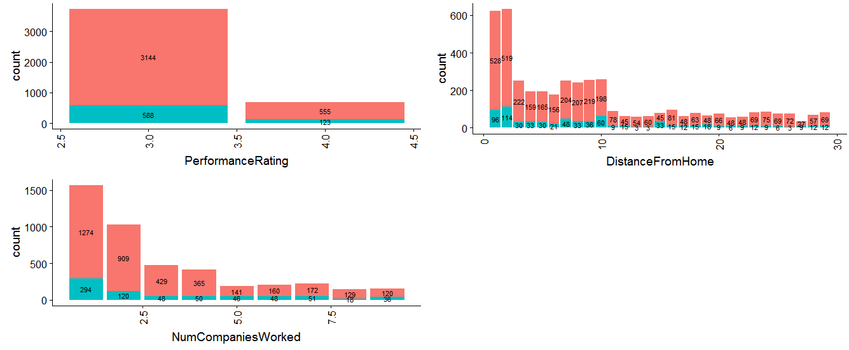

Slide 14
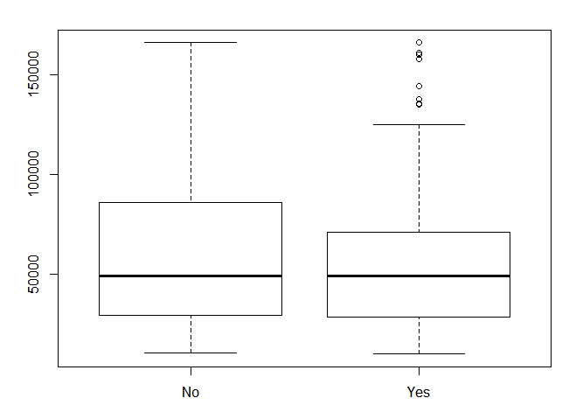
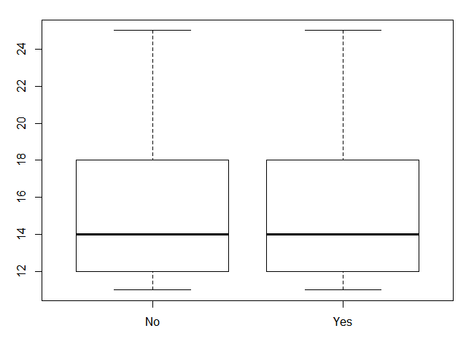
BoxPlot of Attrition vs Monthly Income and Percent salary hike

Slide 15
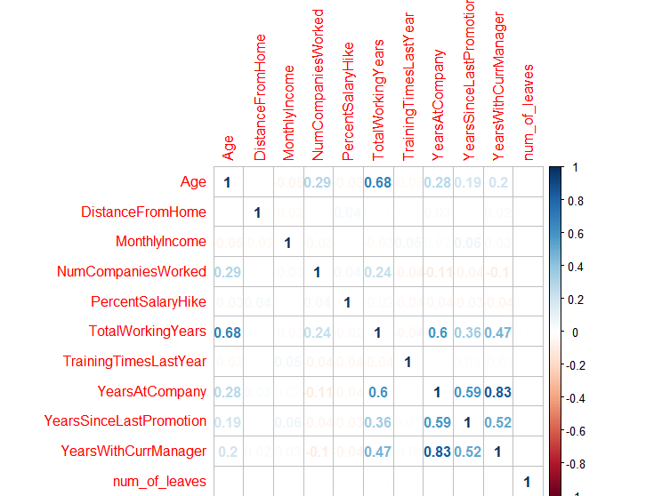
Correlation plot between all continuous variable
1. ”Age” and “Total working Years” are highly correlated.
2. “Years at company” and “year with current manager” are highly correlated
Insight - When the Revolving Utilization is high, loan default rate is high

Slide 16
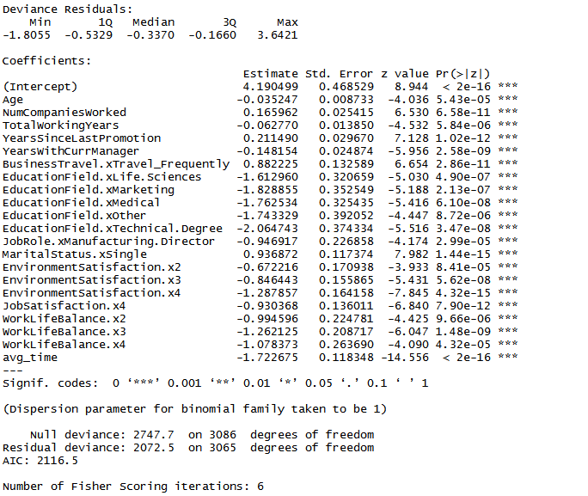
Final model obtained after applying logistic regression algorithm

Slide 17
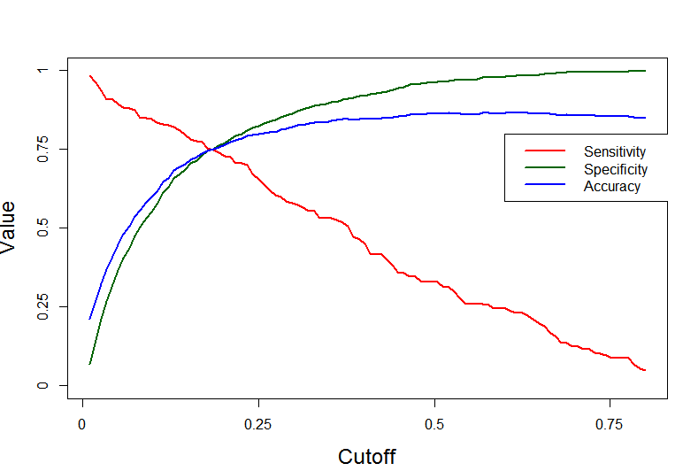
Model Evaluation
After analyzing value od Accuracy, specificity and sensitivity we have chosen the value of cutoff as 0.185.
Matrix | Value
Accuracy | 0.7498
Sensitivity | 0.7488
Specificity | 0.75
KS Statistic | 04987

